Slide 1
The State of the Retail Market 2011
Duane Debelak, Vice President
The Appraisal Resource Group, Inc.
225 E. Mason St., Suite 402
Milwaukee, WI 53202

Slide 3
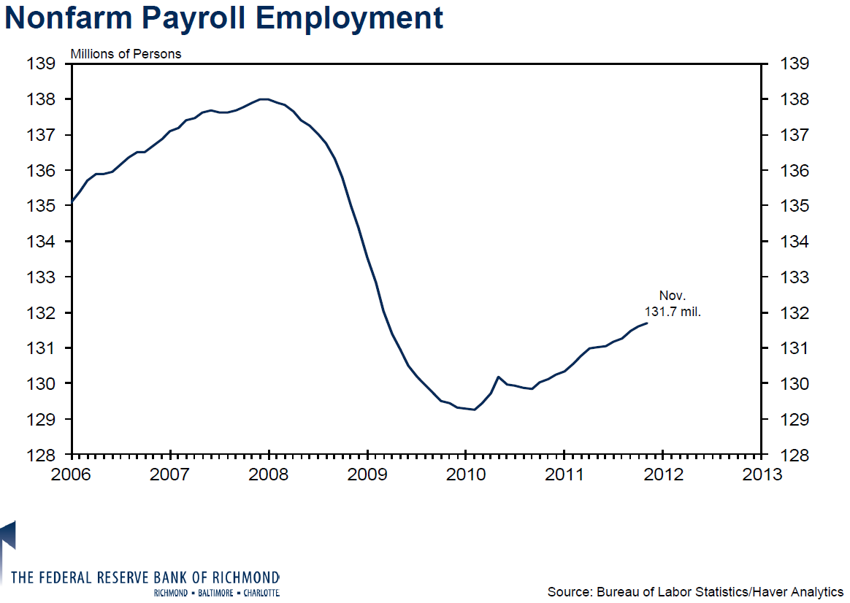

Slide 4
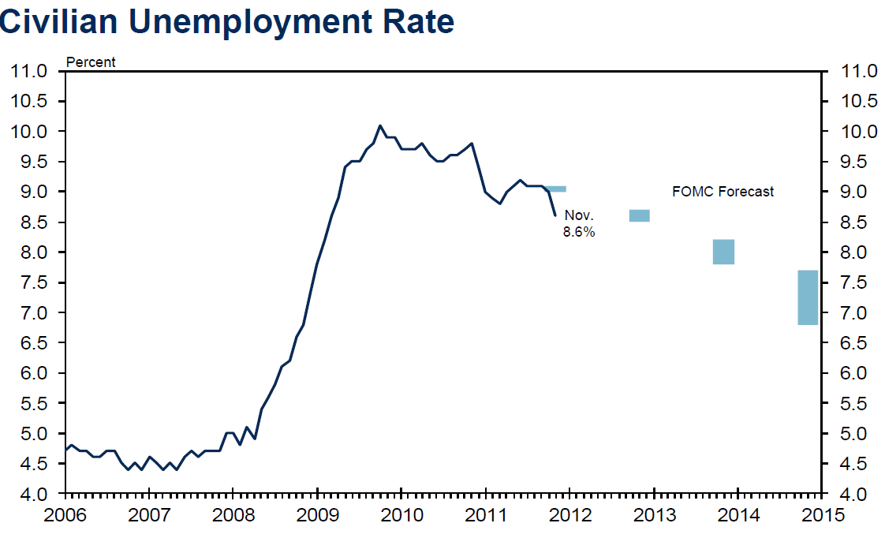

Slide 6
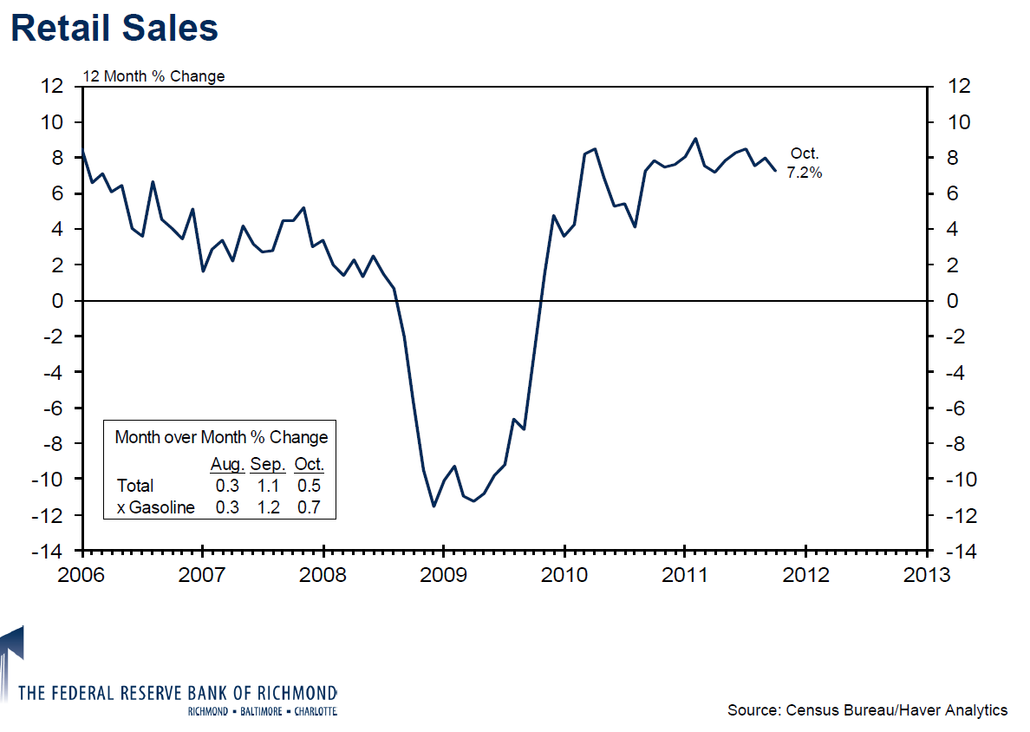

Slide 7
Increase in E-Commerce Sales in 2011
Cyber Monday sales a record $1.25 billion, up 22% from 2010.
First 32 days of November/December 2011 holiday season $18.7 billion, up 15% from 2010.
Black Friday total weekend sales up 9% to $399 per consumer, of which 38% or $151 was online.

Slide 8
Wisconsin Employment
 | January 2010 | January 2011 | October 2011
Unemployment Rate | 10.0% | 8.2% | 6.8%
Employment | 2,752,212 | 2,773,973 | 2,845,801
Increase (1/11-10/11) |  |  | 71,828
Increase (1/10-10/11) |  |  | 93,589

Slide 9
Milwaukee-Waukesha MSA Employment
 | January 2010 | January 2011 | October 2011
Unemployment Rate | 10.0% | 8.2% | 7.5%
Employment | 715,205 | 727,543 | 741,853
Increase (1/11-10/11) |  |  | 14,310
Increase (1/10-10/11) |  |  | 26,648

Slide 10
Milwaukee Area (SE Wisconsin) Costar Total Retail Market Vacancy
 | December 2010 (Year End) | June 2011 (2nd Quarter) | September 2011 (3rd Quarter)
Retail Space Vacancy Rate | 6.6% | 7.1% | 6.9%
Average Quoted Rental Rate | $11.45 | $11.24 | $11.02

Slide 11
Milwaukee Metro Retail Growth
2010
2011
720,000 square feet of retail space delivered.
485,000 square feet of retail space to be delivered.
Notes:
Marcus & Millichap

Slide 12
Metro Growth/Redevelopment Areas
Pewaukee near Capitol Drive and Highway 164 (148,000 s.f. Costco, 17,900 s.f. Aldi, Menard’s partial conversion/expansion to include 26,000 s.f. garden center and 18,000 s.f. greenhouse, Tires Plus, Taco Bell)
West Milwaukee along Miller Park Way
(60,000 s.f. Cermak Fresh Market, 15,000 s.f. GFS, 20,000 s.f. Auto Zone, 7,600 s.f. Firestone, 147,800 s.f. Wal-Mart)
Southridge Mall on S. 76th Street in Greendale (150,000 s.f. Macy’s in old 210,000 s.f. Younker’s. Resistance by Bon-Ton quelled. Part of $52.5 million Mall renovation. 92,400 s.f. Wal-Mart plus two front outlots on Bowling Congress site west of Mall.)
Notes:
Macy’s store size smaller than 280,000 s.f. Macy’s at Mayfair.
Both West Milwaukee and Greendale developments involve TIF Districts.
Scattered individual projects, such as a Wal-Mart and True Value in Muskego.

Slide 13
Big Box Developments
140,000 s.f. Target on Bluemound Road in Brookfield/Elm Grove on old printing plant site. Three front outlots of which one will be a PNC Bank branch.
140,000 s.f. Wal-Mart Supercenter just east of existing Wal-Mart in Greendale at NEQ of Highway 100 and Layton Avenue.

Slide 14
Milwaukee Area Store Closures
Lowe’s (Brown Deer Road)
Borders (All area locations. Planet Fitness to open in downtown Borders. Burghardt Sporting Goods and Fresh Market for Fox Point Store. Shoe store considering Southridge Borders, but at a much lower rental rate.)
Blockbuster (various locations)

Slide 15
Retailers Looking to Expand
Woodman’s (Waukesha at Hwy. 164 & Main)
Wal-Mart (NW Milwaukee Timmerman Plaza, Men. Falls, South Milwaukee, Town of Waukesha old store, Greendale, West Milwaukee)
Aldi
Auto Zone
CVS
GFS (Franklin)
Notes:
Home improvement stores are not looking to expand as of 2011. (no new Lowe’s, Home Depot, Menard’s)

Slide 16
The Corners Von Maur Project
$100 million 455,000 square foot retail and office project.
140,000 s.f. Von Maur anchor, 90,000 s.f. other retail and restaurants.
225,000 s.f. office space plus a 1,900 s.f. parking deck.
Notes:
Von Maur originally sought to locate at Brookfield Square but Bon-Ton vetoed.

Slide 17
The Corners Van Maur Project, Town of Brookfield
3 Mile Radius
5 Mile Radius
37,469 Population
15,396 Households
$115,864 Average Household Income
72,868 Daytime Population
115,661 Population
47,000 Households
$102,644 Average Household Income
181,375 Daytime Population
Located at the East Quadrant of Bluemound (40,200), Barker Road, & I-94 (118,000)

Slide 18
The Corners Von Maur Anchored Project
Bluemound Road to the North (bottom)
I-94 to the South (top)
Barker Road further to the West (right)

Slide 19
Grocery Anchored Centers
Brookfield/Sendik’s Town Center, Brookfield, WI
The Brownstone’s Metro Market, Brookfield, WI
SWQ Capitol Dr. (33,900) & Brookfield Rd. (10,900)
32,173 Population
(3 Mile Radius)
11,863 Households
$139,049 Average Household Income
32,986 Daytime Population
NWQ Bluemound (42,900) & Calhoun Rd. (17,800)
40,034 Population
(3 Mile Radius)
16,368 Households
$134,177 Average Household Income
73,460 Daytime Population

Slide 20
Grocery Anchored Centers – Sales
Brookfield/Sendik’s Town Center, Brookfield, WI
The Brownstone’s Metro Market, Brookfield, WI
Sale Date – October 17, 2011
Sale Price - $15,400,000
188,122 Square Feet
18% Vacancy
2001-2006
$82/S.F.
Seller – BMO Harris (REO)
Buyer – Phillips Edison Co.
(Cincinnati based, owns 250 retail centers with 26 million s.f.)
Sale Date – December 5, 2011
Sale Price - $24,100,000
137,821 Square Feet
3% Vacancy
1989 (2010 renovation)
$175/S.F.
Seller – BB&K/Brownstones (CA)
Buyer – Inland Real Estate (Oak Brook based, owns 129 million s.f.)

Slide 21
PWC Retail Cap Rate History
3rd Quarter 2007
3rd Quarter 2011
Average of 7.20%
Average of 7.20%
Net Change of 0 Basis Points in the Past Four Years
Decline of 89 Basis Points in the Past Year
Notes:
Price Waterhouse Coopers Korpacz Strip Center

Slide 22
2011 Credit Net Lease Cap Rate
6.50% Walgreens in West Bend, WI (Under Contract)
(typical new net lease Walgreens overall rate is 6.50% to 6.75% with 25 year guarantee)
Seller - Developer
Buyer – New York 1031 Exchange Investor
Notes:
S&P investment grade A+ rating $385 per s.f., 24 year self amortizing loan, 60% LTV near 5.0%, debt constant near 7.15%, equity rate near 5.5%.
On south Main Street. Another Walgreens on north side of West Bend on Washington under contract with 6.62% overall rate.
Wal-Mart AA
1031 buyers

Slide 23
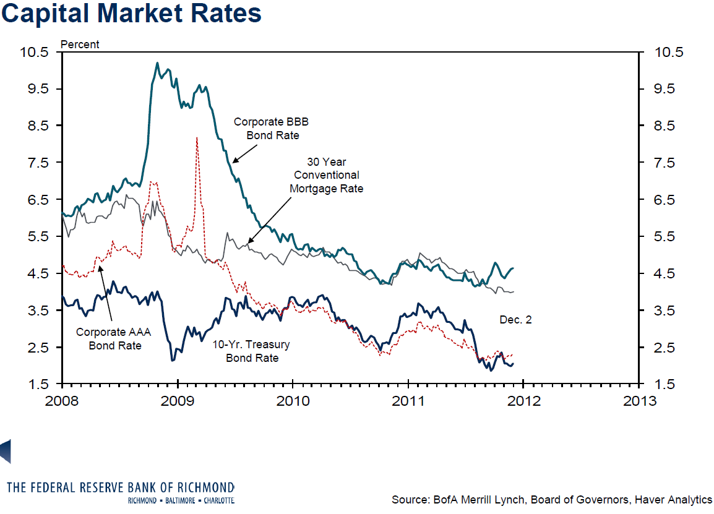

Slide 24
Third Quarter 2011 PWC Investor Survey
Average Capitalization Rate of 7.20% for Institutional Grade Retail Properties
Average Capitalization Rate of 9.70% for Non-Institutional Grade Retail Properties
Current spread of 250 basis points. In 2007, the spread was only 145 basis points.

Slide 25
$$$$$
The following is a slide from the 2007 Presentation:
Over the past five years, owners of retail real estate have enjoyed substantial value increases for two primary reasons:
1) Compression in Overall Rates
2) Increase in Net Operating Income
However, the outlook for 2008 is less favorable
Notes:
In the next year, both primary paths to increasing value will be under pressure
Cap rates stabilized
Downward pressure on retail rents with potential excess supply

Slide 26
Retail Market Conclusion - 2011
Hopefully, we may have bottomed out.
Notes:
Lets by hopeful

